Slide 1
Natural Language Processing
Jacob Eisenstein
Direct Studies - Book Report
By Mahtab Tamannaee
Winter 2021

Slide 2
Chapter 6
Language models

Slide 3
Language models
Let's consider the problem of computing the probability of text itself.
We will consider models that assign probability to a sequence of word tokens, p(w1, w2, . . . , wM), with wm ∈ V. The set V is a discrete vocabulary.
V = {aardark, abacus, . . . , zither}.
N-gram language models: A simple approach to computing the probability of a sequence of tokens is to use a relative frequency estimate.

Slide 4

N-gram language models
We begin with n-gram language models, which compute the probability of a sequence as the product of probabilities of subsequences.
The probability of a sequence p(w) = p(w1, w2, . . . , wM) can be refactored using the chain rule.
Each element in the product is the probability of a word given all its predecessors. We can think of this as a word prediction task.

Slide 5


N-gram language models
N-gram models make a crucial simplifying approximation as they condition on only the past n − 1 words.
Therefore, the probability of a sentence w can be approximated as:
The n-gram probabilities can be computed by relative frequency estimation:

Slide 6


N-gram language models:
The hyperparameter N controls the size of the context used in each conditional probability.
Unigram Model
Bigram Model

Slide 7
N-gram language models:
The hyperparameter N controls the size of the context used in each conditional probability. If this is misspecified, the language model will perform poorly.
Consider the following sentence “Gorillas always like to groom their friends”. The likelihood of ‘their’ depends on knowing that ‘gorillas’ is plural.
When n is too small,the n-grams are not big enough to capture this context, then the resulting language model would offer probabilities that are too low for these sentences. Small n-gram size introduces high bias.
When n is too big,it is hard good estimates of the n-gram parameters from our dataset, because of data sparsity. Large n-gram size introduces high variance

Slide 8

Smoothing
A major concern in language modeling is to avoid the situation p(w) = 0, which could arise as a result of a single unseen n-gram. The solution is smoothing.
This basic framework is called Lidstone smoothing, but special cases have other names:
Laplace smoothing corresponds to the case α = 1.
Jeffreys-Perks law corresponds to the case α = 0.5, which works well in practice and benefits from some theoretical justification

Slide 9


Discount
To ensure that the probabilities are properly normalized, anything that we add to the numerator (α) must also appear in the denominator (Vα). This idea is reflected in the concept of effective counts.
Where ci is the count of event i, c ∗ i is the effective count, and M is the total number of tokens in dataset (w1, w2, . . . , wM). The discount for each n-gram is then computed

Slide 10
Discounting and backoff
Another approach would be to borrow the same amount of probability mass from all observed n-grams, and redistribute it among only the unobserved n-grams. This is called absolute discounting.
Discounting reserves some probability mass from the observed data, and we do not need redistribute this probability mass equally. Instead, we can backoff to a lower-order language model. This is called Katz backoff.

Slide 11
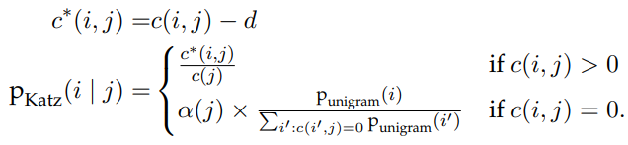
Discounting and backoff pt2
Simple case of backing off from bigrams to unigrams:
The term α(j) indicates the amount of probability mass that has been discounted for context j. This probability mass is then divided across all the unseen events, {ii : c(ii , j) = 0}, proportional to the unigram probability of each word ii.
The discount parameter d can be optimized to maximize performance on a development set.

Slide 12
Recurrent neural network language models
The first insight behind neural language models is to treat word prediction as a discriminative learning task.
The goal is to compute the probability p(w | u), where w ∈ V is a word, and u is the context, which depends on the previous words.
Rather than directly estimating the word probabilities from (smoothed) relative frequencies, we can treat treat language modeling as a machine learning problem, and estimate parameters that maximize the log conditional probability of a corpus.

Slide 13

Recurrent neural network language models pt2
The second insight is to reparametrize the probability distribution p(w | u) as a function of two dense K-dimensional numerical vectors, βw and vu. where (βw·vu) represents a dot product.
This vector of probabilities is equivalent to applying the softmax transformation to the vector of dot-products.
The word vectors βw are parameters of the model, and are estimated directly.
The context vectors vu can be computed in various ways, depending on the model.

Slide 14
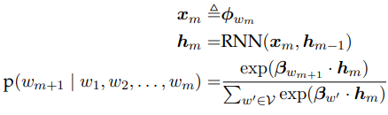
Recurrent neural network language models pt3
A simple but effective neural language model can be built from a recurrent neural network.
The basic idea is to recurrently update the context vectors while moving through the sequence.
Let hm represent the contextual information at position m in the sequence, RNN language models are defined as following:

Slide 15
Recurrent neural network language models pt4
In the following formula for RNN language models, φ is a matrix of word embeddings, and xm denotes the embedding for word wm.
The conversion of wm to xm is sometimes known as a lookup layer, because we simply lookup the embeddings for each word in a table.

Slide 16

Recurrent neural network language models pt5
The Elman unit defines a simple recurrent operation. In which, Θ is the recurrence matrix and g is a non-linear transformation function, often defined as the elementwise hyperbolic tangent tanh.
The tanh acts as a squashing function, ensuring that each element of hm is constrained to the range.
Although each wm depends on only the context vector hm−1, this vector is in turn influenced by all previous tokens, w1, w2, ... wm−1, through the recurrence operation: w1 affects h1, which affects h2, and so on, until the information is propagated all the way to hm−1, and then on to wm

Slide 17

Recurrent neural network language models pt6
The recurrent neural network language model has the following parameters:
Each of these parameters can be estimated by formulating an objective function over the training corpus, L(w), and then applying backpropagation to obtain gradients on the parameters from a minibatch of training examples

Slide 18


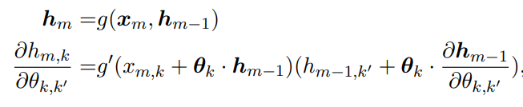
RNN LM : Backpropagation through time
Backpropagation in RNNis known as backpropagation through time. The gradients on units at time m depend in turn on the gradients of units at earlier times n < m. Let Lm+1 represent the negative log-likelihood of word m + 1.
The loss depends on the parameters only through hm.
The vector hm depends on Θ in several ways.First, hm is computed by multiplying Θ by the previous state hm−1. But the previous state hm−1 also depends on Θ

Slide 19

RNN LM : Backpropagation through time pt2
The g’ is the local derivative of the nonlinear function g.
Each derivative , will be reused many times as it appears in backpropagation from the loss Lm, but also in all subsequent losses Ln>m

Slide 20
RNN language model Hyperparameters
The RNN language model has several hyperparameters that must be tuned to ensure good performance.
The model capacity is controlled by the size of the word and context vectors K, which play a role that is somewhat analogous to the size of the n-gram context.
For datasets that are large with respect to the vocabulary, we can afford to estimate a model with a large K, which enables more subtle distinctions between words and contexts.
When the dataset is relatively small, then K must be smaller too, or else the model may “memorize” the training data, and fail to generalize.

Slide 21
Gated recurrent neural networks
The long short-term memory (LSTM) is a popular variant of RNNs that is more robust to vanishing gradients an exploding gradients problems.
Because the memory cell is not passed through a nonlinear squashing function during the update, it is possible for information to propagate through the network over long distances.
The gates are functions of the input and previous hidden state. They are computed from elementwise sigmoid activations. Each gate is controlled by a vector of weights, which parametrize the previous hidden state.

Slide 22
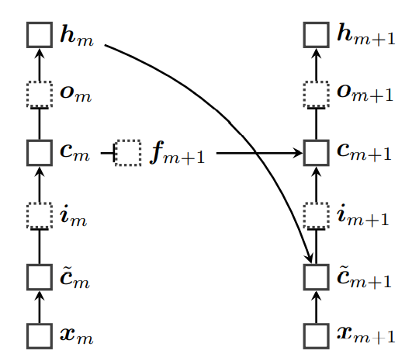
Gated recurrent neural networks
This model augments the hidden state hm with a memory cell cm.
The value of the memory cell at each time m is a gated sum of two quantities: its previous value cm−1, and an “update” c˜m, which is computed from the current input xm and the previous hidden state hm−1.
The next state hm is then computed from the memory cell.

Slide 23
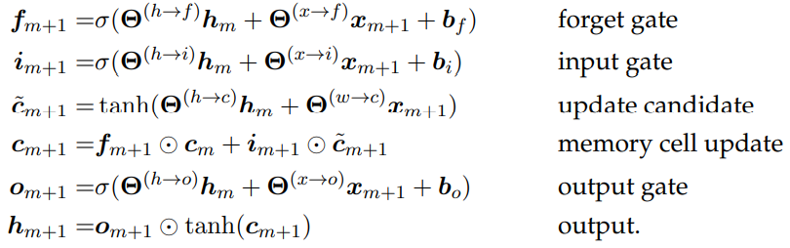

Slide 24
Evaluating language models
Language models are typically components of larger systems. They would ideally be evaluated extrinsically. But this is often hard to do, because extrinsic evaluation depends on details of the overall system.
In contrast, intrinsic evaluation is task-neutral.
Better performance on intrinsic metrics may be expected to improve extrinsic metrics across a variety of tasks, but there is always the risk of over-optimizing the intrinsic metric.

Slide 25
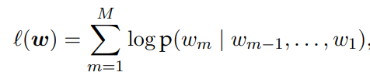
Evaluating language models: Held-out likelihood
The goal of probabilistic language models is to accurately measure the probability of sequences of word tokens.
Therefore, an intrinsic evaluation metric is the likelihood that the language model assigns to held-out data, which is not used during training.
We compute the following as we treat the entire held-out corpus as a single stream of tokens

Slide 26
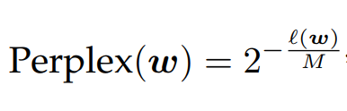
Evaluating language models: Perplexity
Held-out likelihood is usually presented as perplexity, which is a deterministic transformation of the log-likelihood into an information-theoretic quantity, where M is the total number of tokens in the held-out corpus:
Lower perplexities correspond to higher likelihoods, so lower scores are better on this metric.

